Slide 1
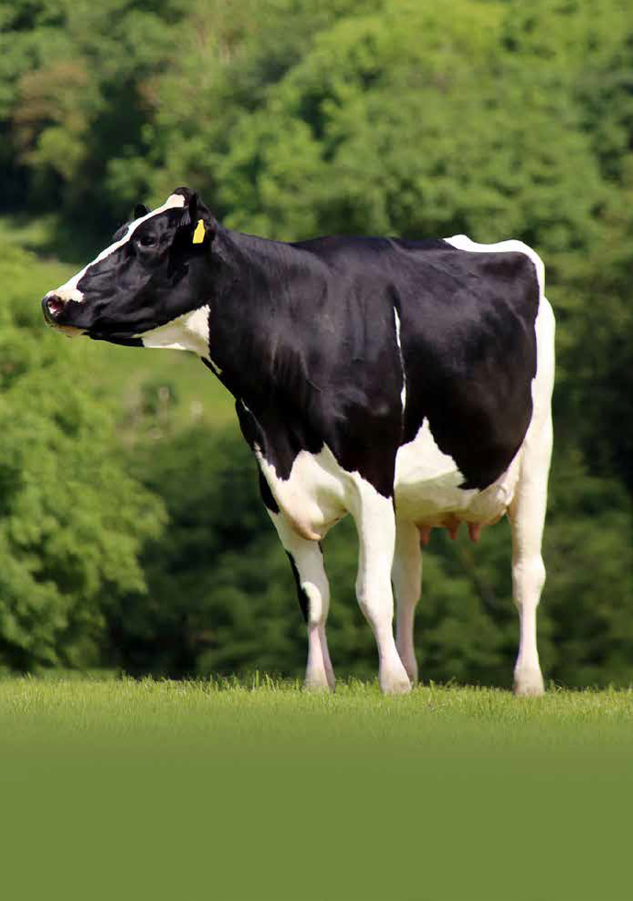

GRAZING
SPRING 2021 CATALOGUE
Part of the
group.
www.stgen.com

Slide 2
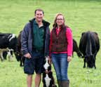
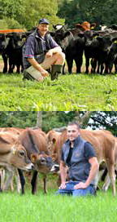
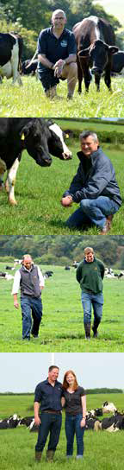
INDEX
Economic breeding index (€EBI) Explained
The EBI base was developed in 2000 to ensure continued genetic gain on Irish farms. Farms that are
typically grazing their herds for the majority of the year and that require cows to produce high quality milk from grass alone. It is also important for Irish cows to calve regularly, ensuring calving blocks stay tight and the most can be made of the summer grazing months.
4 Absolute
5 Allie
6 Andrew
7 Alvi
The EBI base aims to develop a cow which can deliver the following:
High solids
Good fertility
Increased Longevity
Functional cattle with reduced stature but balanced frames
Respond to concentrate when fed if milk price is high, but if milk price is
low can sustain themselves off low input whilst getting back in calf with minimal costs.
8 Components
9 Faithful
Welcome to the Spring 2021 edition of the Cogent Grazing Catalogue.
2020 provided us all with uncertainty but as we move into 2021, Cogent remains driven to offering genetic based solutions to dairy farmers that help to drive on-farm profitability.
One of the biggest influencers on profitability for grazing customers is a cow’s ability to produce high quality milk from one of the cheapest feeds available. Grass.
10 Fionn
11 Grandslam
12 High
EBI sires have allowed Irish farmers to work towards the following key goals:
80% of herd calving in 6 weeks
Achieving less than 10% empty cows per year from 12 weeks of breeding
Average cow in herd lasting 5 – 6 lactations.
Breeding cows that produce 8% + solids (3.7% Protein & 4.3% Fat)
Breeding cows that can produce 0.8 – 1.0 kilo of milk solids per kilo of body weight from grass each year
13 Lancaster
14 Larry
15 Lion King
16 Maestro
17 Magic
With this in mind we have built a comprehensive offering with a diverse range of bulls to suit any grazing system. Irish EBI make up 75% of these and offer confidence to farmers through the research and development that has gone into this index to steer for a profitable, efficient grazing cow. The remainder are bulls specifically selected for traits suited to block calving systems.
18 Magnifico
Milk Sub Index | Fertility Sub Index | Calving Sub Index
Takes into account component production with a small emphasis on volume | Includes both calving interval and survival, fertile cows last longer in the herd and will reduce calving interval | Direct and Maternal calving ease and gestation length are included in this figure with easy calving and lower gestation being desirable
Beef Sub Index | Maintenance Sub Index | Health Sub Index
High value indicates better cull cow value and carcass weight with a direct correlation to calf value. | Reduced stature and a balanced body condition will yield a high value here, meaning reduced maintenance costs | High index indicates a reduction in Mastitis, SCC and Lameness incidence
19 Major
20 Mystic
21 Olympus
23 Porter
24 Ricki
25 Salah
26 Wonder
A new product offering further enhances this genetic efficiency and with the introduction of 4M High Purity in this catalogue, farmers can now be confident in their breeding decisions. 4M High Purity Is the most precise sex sorted semen on the market with 96- 97% gender accuracy. This offering will help to ensure long term, sustainable profitability for generations to come.
Calving Interval | Bulls with negative figures for calving interval will reduce calving interval of their daughters by the number of days indicated
Survival % | Bulls with a positive value will increase longevity of their daughters
DcE | Measured as a percentage, with this being the percentage of difficult calving’s seen with that bull
Gestation Length | A negative figure is a reduction in the average gestation length of a HO/FR of 282 days, low gestation length bulls will suit late season breeding
Milking Speed | A lower figure indicates a quicker milking speed with the figure measured in seconds
SCC and Mastitis | Lower figures are desirable and will reduce incidence of both
Lameness | Lower figures are desirable and will reduce lameness
27 Banging
28 Benny Red
29 Brilliant
AHDB.
by
supplied data
fitness and
Production
30 Fortune
31 Goldtop
Jefferies
Joseph
Origin
Penrod
Bulls tested free for genetic recessives will not show these codes for formatting reasons
2|
Front cover: Dam of Curra Salah
|3

Slide 3









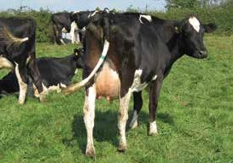
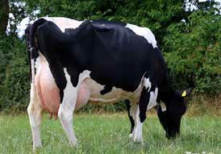
IRISH HOLSTEIN FRIESIAN
FERTILITY SCC
CALVING EASE
LOW GESTATION
IRISH HOLSTEIN FRIESIAN
FERTILITY
MILK
CALVING EASE
LOW GESTATION
Jeanjo ABSOLUTE
Breanshamore ALLIE
ONLY AVAILABLE IN
Dam Jeanjo KOZ Anna 3066 G79
EBI Data
Source: ICBF Nov 2020
Dam Breanshamore MJI Elma 1218
EBI Data
Source: ICBF Nov 2020
Rel EBI & Sub Indices
P | € | Rel | EBI & Sub Indices
 |  |  | 0% |  | 25% |  |  | 50% |  |  | 75% |  | 100%
EBI | € 242 | 80%
Milk | € 63 | 95%
Health | € 8 | 74%
Fertility | € 103 | 65%
Calving | € 61 | 90%
Management | € 5 | 69%
Maintenance | € 24 | 72%
Beef | -€ 20 | 88%
P
€
EBI
€ 293
63%
0%
25%
50%
75%
100%
Milk
€ 95
78%
Health
€ 6
66%
Fertility
€ 123
48%
Calving
€ 57
83%
Royal Laurence x OJI Haze x Dauntless HBN: HOLIRLM161260264354
AI Code: HO5079 Breed: 78% HO 19% FR 3% JE
Anton x OJI Frank x Slick Knife HBN: HOIRLM217174292209
AI Code: HO6119 Breed: Breed 75% HO 25% FR
Dam: Breanshamore MJI Elma 1218 2nd Dam: SSI Elma 700
3rd Dam: Derryvunlan JWH Elma
Management
€ 3
58%
Dam: Jeanjo Koz Anna 3066 G79
Maintenance
€ 10
50%
2nd Dam: Jeanjo Dauntless Anna 1910 3rd Dam: Jeanjo Apache Anna 1213
Beef
-€ 1
50%
SCI & ACI Data
Source: AHDB Dairy-Dec 2020
SCI & ACI Data
Source: AHDB Dairy-Dec 2020
SCI | ACI | Rel %
290 | 344 | 63
Prod Dtrs | 121 | Prod Hrds | 47
SCI | ACI | Rel %
258 | 317 | 64
Prod Dtrs | 0 | Prod Hrds | 0
PRODUCTION
PRODUCTION
Milk Kgs | 44
Fat Kgs | 9.3 | Fat % | 0.13
Protein Kgs | 8.1 | Protein % | 0.12
Milk Kgs | 291
Fat Kgs | 17.3 | Fat % | 0.1
Protein Kgs | 14.6 | Protein % | 0.08
Milk Kgs | Fat Kgs | Protein Kgs | Prod Dtrs
10 | 5.1 | 8.1 | 0
Rel % | Fat % | Protein % | Prod Hrds
67 | 0.09 | 0.15 | 0
Milk Kgs | Fat Kgs | Protein Kgs | Prod Dtrs
176 | 9.8 | 12 | 0
Rel % | Fat % | Protein % | Prod Hrds
67 | 0.04 | 0.12 | 0
HEALTH
HEALTH
Lameness | -0.03 | SCC | -0.05
Mastitis | -0.04 | TB (%) | 8.32
Lameness | -0.03 | SCC | -0.03
Mastitis | -0.03 | TB (%) | 6.92
FERTILITY
FERTILITY
Production and fitness data supplied by AHDB.
Calv. Int (Days) | -6.59 | Survival (%) | 1.58
Production and fitness data supplied by AHDB.
Calv. Int (Days) | -7.68 | Survival (%) | 2.08
SCC | Mastitis | Lameness | Lifespan
-2 | -1 | 0 | 39
Fert Index | Maint | TB Adv | D Carcase
6.3 | -3 | 0.6 | -1.4
Calf Surv | DcE | McE | D Dermatitis
4.3 | 1.5 | 0.5 | 0.1
CALVING
SCC | Mastitis | Lameness | Lifespan
0 | -1 | -0.6 | 82
Fert Index | Maint | TB Adv | D Carcase
3 | 9 | 1.8 | 0.2
Calf Surv | DcE | McE | D Dermatitis
0.7 | 1.9 | 0.7 | 0.2
CALVING
Risk of DH Cdiff | Low | McE | 5.01
DcE (Heifers) | 4.57 | Gestation (Days) | -5.27
DcE (Cows) | 2.03 | Mortality | -0.86
Risk of DH Cdiff | Low | McE | 5.36
DcE (Heifers) | 4.14 | Gestation (Days) | -4.86
DcE (Cows) | 1.93 | Mortality | -0.82
MANAGEMENT
MANAGEMENT
Temperament | 0.01 | Milk Speed | -13.7
Temperament | -0.06 | Milk Speed | -16.84
MAINTENANCE
MAINTENANCE
Stature | -1.03 | Body Condition | 0.15
Stature | -0.86 | Body Condition | 2.16
4|
PROVEN SIRE
GENOMIC SIRE
|5

Slide 4
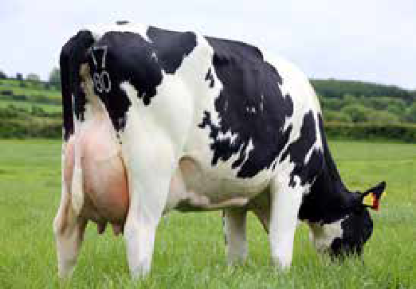
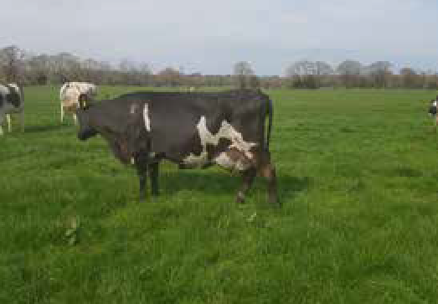
IRISH HOLSTEIN FRIESIAN
STATURE
COMPS
FERTILITY
CALVING EASE
IRISH CROSSBRED
NEW
CALVING EASE
HIGH EBI
COMPS
Cillwalsh ANDREW
Coolnasoon ALVI
COMING SOON
Dam Cillwalsh Ann 25
EBI Data
Source: ICBF Nov 2020
Dam of Coolnasoon ALVI
EBI Data
Source: ICBF Nov 2020
P | € | Rel | EBI & Sub Indices
 |  |  | 0% |  | 25% |  |  | 50% |  |  | 75% |  | 100%
EBI | € 222 | 61%
Milk | € 99 | 77%
Health | -€ 1 | 64%
Fertility | € 85 | 46%
Calving | € 45 | 82%
Management | € 1 | 56%
Maintenance | € 9 | 46%
Beef | -€ 15 | 48%
P | € | Rel | EBI & Sub Indices
 |  |  | 0% |  | 25% |  |  | 50% |  |  | 75% |  | 100%
EBI | € 299 | 49%
Milk | € 134 | 68%
Health | € 6 | 53%
Fertility | € 96 | 32%
Calving | € 54 | 53%
Management | € 9 | 48%
Maintenance | € 9 | 43%
Beef | -€ 10 | 42%
Vincent x Sam 936 x Prince HBN: HOLIRLM217532112045
AI Code: HO5941 Breed: 75% HO 25% FR
Albert x Manzello x Aristotle HBN: HOIRLM219081653906
AI Code: HO6606 Breed: 53% HO19% FR 25% JE 3% UN
Dam: IE141827822316
2nd Dam: Coolnasoon Viola 25 GP83 3rd Dam: Coolnasoon Viola 15 GP82
Dam: Cillwalsh Ann 25
2nd Dam: Cillwalsh Ann 3
3rd Dam: Cillwalsh CWJ Ann 2
SCI & ACI Data
Source: AHDB Dairy-Dec 2020
SCI & ACI Data
Source: AHDB Dairy-Dec 2020
SCI | ACI | Rel %
297 | 328 | 64
Prod Dtrs | 0 | Prod Hrds | 0
SCI
ACI
Rel %
Prod Dtrs
0
Prod Hrds
0
PRODUCTION
PRODUCTION
Milk Kgs | 73
Fat Kgs | 11.3 | Fat % | 0.15
Protein Kgs | 13.9 | Protein % | 0.2
Milk Kgs | 266
Fat Kgs | 23.8 | Fat % | 0.22
Protein Kgs | 18.4 | Protein % | 0.16
Milk Kgs | Fat Kgs | Protein Kgs | Prod Dtrs
-151 | 2.2 | 4.7 | 0
Rel % | Fat % | Protein % | Prod Hrds
67 | 0.18 | 0.2 | 0
SCI | ACI | Rel % | **
SCI | ACI | Rel % | **
HEALTH
HEALTH
Lameness | -0.02 | SCC | 0.03
Mastitis | 0.01 | TB (%) | 9.64
Lameness
-0.05
SCC
-0.02
Mastitis
-0.02
TB (%)
8.53
FERTILITY
FERTILITY
Production and fitness data supplied by AHDB.
Calv. Int (Days) | -4.15 | Survival (%) | 2.63
Production and fitness data supplied by AHDB.
Calv. Int (Days) | -4.58 | Survival (%) | 3.05
SCC | Mastitis | Lameness | Lifespan
7 | 0 | -0.2 | 57
Fert Index | Maint | TB Adv | D Carcase
11.9 | 3 | 0.1 | 1.9
Calf Surv | DcE | McE | D Dermatitis
2.3 | 1.5 | 0.6 | -0.1
CALVING
SCI
ACI
Rel %
**
CALVING
Risk of DH Cdiff | Low | McE | 5.33
DcE (Heifers) | 5.33 | Gestation (Days) | -3.61
DcE (Cows) | 1.81 | Mortality | -0.42
Risk of DH Cdiff
Low
McE
4.91
DcE (Heifers)
5.31
Gestation (Days)
-5.13
SCI
ACI
Rel %
**
DcE (Cows)
2.51
Mortality
-0.29
MANAGEMENT
MANAGEMENT
Temperament | -0.01 | Milk Speed | -5.2
SCI
ACI
Rel %
Rel %
Temperament
0.15
Milk Speed
-11.45
MAINTENANCE
MAINTENANCE
Stature | -1.25 | Body Condition | 0.69
Stature | -0.64 | Body Condition | -0.56
6|
GENOMIC SIRE
GENOMIC SIRE
|7

Slide 5



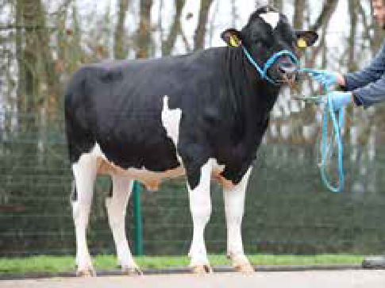
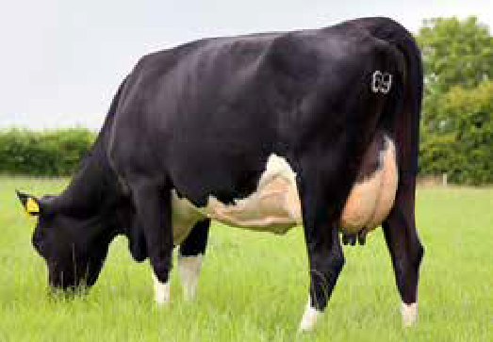
IRISH HOLSTEIN FRIESIAN
NEW
CALVING EASE
FERTILITY
COMPS
IRISH HOLSTEIN FRIESIAN
STATURE LAMENESS COMPS
CALVING EASE
Ballinard COMPONENTS
COMING SOON
Possextown
FAITHFUL
HIGH
PURITY
EBI Data
Source: ICBF Nov 2020
Rel EBI & Sub Indices
Dam: Possextown Ellie 866
EBI Data
Source: ICBF Nov 2020
Rel EBI & Sub Indices
P
€
P
€
EBI
€ 282
60%
0%
25%
50%
75%
100%
EBI
€ 248
87%
0%
25%
50%
75%
100%
Milk
€ 108
78%
Milk
€ 89
98%
Health
€ 9
66%
Health
€ 9
82%
Fertility
€ 111
48%
Fertility
€ 104
75%
Calving
€ 58
57%
Calving
€ 43
93%
Harry x Harold x Tossy
HBN: HOIRLM225789381724
AI Code: HO6595 Breed: 78% HO 22% FR
Management
€ 4
56%
Odie x Hammer x Eminence Dano HBN: HOLIRLM281565481002
AI Code: HO4746 Breed: 66% HO 34% FR
Management
€ 4
76%
Dam: Ballinard Corona 797
Maintenance
€ 9
46%
Dam: Possextown Ellie 866
Maintenance
€ 13
88%
2nd Dam: Ballinard Corona 457 3rd Dam: Corona 3
Beef
-€ 17
46%
2nd Dam: Possextown HZO Ellie 3rd Dam: Possextown LYE Ellie
Beef
-€ 16
95%
SCI & ACI Data
Source: AHDB Dairy-Dec 2020
SCI & ACI Data
Source: AHDB Dairy-Dec 2020
SCI | ACI | Rel %
321 | 353 | 63
Prod Dtrs | 0 | Prod Hrds | 0
SCI | ACI | Rel %
268 | 307 | 73
Prod Dtrs | 423 | Prod Hrds | 188
PRODUCTION
PRODUCTION
Milk Kgs | -208
Fat Kgs | 19.5 | Fat % | 0.5
Protein Kgs | 8.3 | Protein % | 0.28
Milk Kgs | 30
Fat Kgs | 15.2 | Fat % | 0.24
Protein Kgs | 10.3 | Protein % | 0.16
Milk Kgs | Fat Kgs | Protein Kgs | Prod Dtrs
-365 | 14.1 | 3.4 | 0
Rel % | Fat % | Protein % | Prod Hrds
66 | 0.63 | 0.34 | 0
Milk Kgs | Fat Kgs | Protein Kgs | Prod Dtrs
-58 | 8.9 | 7.9 | 0
Rel % | Fat % | Protein % | Prod Hrds
78 | 0.23 | 0.2 | 0
HEALTH
HEALTH
Lameness | -0.04 | SCC | -0.05
Mastitis | -0.05 | TB (%) | 8.62
Lameness | -0.07 | SCC | -0.02
Mastitis | -0.04 | TB (%) | 7.04
FERTILITY
FERTILITY
Production and fitness data supplied by AHDB.
Calv. Int (Days) | -6.47 | Survival (%) | 2.34
Production and fitness data supplied by AHDB.
Calv. Int (Days) | -5.95 | Survival (%) | 2.38
SCC | Mastitis | Lameness | Lifespan
2 | 0 | 1.7 | 30
Fert Index | Maint | TB Adv | D Carcase
6.5 | 11 | 0.1 | 0.5
Calf Surv | DcE | McE | D Dermatitis
1.5 | 1.1 | 0.6 | 0.1
CALVING
SCC | Mastitis | Lameness | Lifespan
3 | 0 | 0.5 | 27
Fert Index | Maint | TB Adv | D Carcase
3 | -10 | 0.5 | 1.7
Calf Surv | DcE | McE | D Dermatitis
1.2 | 1.4 | 0.4 | 0.1
CALVING
Risk of DH Cdiff | Low | McE | 4.91
DcE (Heifers) | 4.63 | Gestation (Days) | -4.96
DcE (Cows) | 2.02 | Mortality | -0.48
Risk of DH Cdiff | Low | McE | 4.99
DcE (Heifers) | 4.83 | Gestation (Days) | -3.17
DcE (Cows) | 2.1 | Mortality | -0.5
MANAGEMENT
MANAGEMENT
Temperament | 0.04 | Milk Speed | -9.17
Temperament | -0.02 | Milk Speed | -16.43
MAINTENANCE
MAINTENANCE
Stature | -0.18 | Body Condition | 0.72
Stature | -1.71 | Body Condition | 0.53
8|
GENOMIC SIRE
PROVEN SIRE
|9

Slide 6



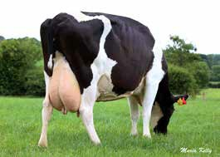
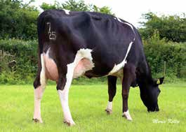
IRISH HOLSTEIN FRIESIAN
MILK
FERTILITY
LOW GESTATION
STATURE
IRISH HOLSTEIN FRIESIAN
HIGH EBI
FERTILITY
COMPS
CALVING EASE
Curra FIONN
Bridepark GRANDSLAM
2nd Dam Curra CWJ Ester (10th Lact)
EBI Data
Source: ICBF Nov 2020
Dam Bridepark AKZ Karen
EBI Data
Source: ICBF Nov 2020
P | € | Rel | EBI & Sub Indices
 |  |  | 0% |  | 25% |  |  | 50% |  |  | 75% |  | 100%
EBI | € 247 | 65%
Milk | € 68 | 79%
Health | € 1 | 68%
Fertility | € 116 | 49%
Calving | € 61 | 89%
Management | € 1 | 60%
Maintenance | € 11 | 51%
Beef | -€ 11 | 59%
P | € | Rel | EBI & Sub Indices
 |  |  | 0% |  | 25% |  |  | 50% |  |  | 75% |  | 100%
EBI | € 264 | 63%
Milk | € 66 | 78%
Health | € 7 | 65%
Fertility | € 145 | 46%
Calving | € 49 | 88%
Management | € 4 | 57%
Maintenance | € 9 | 48%
Beef | -€ 17 | 56%
Anton x Zander Keet x Jordanaire HBN: HOLIRLM222458282249
AI Code: HO5602 Breed: 75% HO 25% FR
Dam: Curra Keet Ester VG86 2nd Dam: Curra CWJ Ester
Black Lightning x Horizon x Frank HBN: HOLIRLM216818280957
AI Code: HO5942 Breed: 84% HO 13% FR 3% JE
Dam: Bridepark AKZ Karen
3rd Dam: Curra Royal Ester F73
2nd Dam: Bridepark Karen MJI 612 3rd Dam: Bridepark BWZ Karen 412
SCI & ACI Data
Source: AHDB Dairy-Dec 2020
SCI & ACI Data
Source: AHDB Dairy-Dec 2020
SCI | ACI | Rel %
176 | 193 | 64
Prod Dtrs | 0 | Prod Hrds | 0
SCI | ACI | Rel %
253 | 306 | 64
Prod Dtrs | 0 | Prod Hrds | 0
PRODUCTION
PRODUCTION
Milk Kgs | 368
Fat Kgs | 13.5 | Fat % | -0.01
Protein Kgs | 12.4 | Protein % | 0
Milk Kgs | -174
Fat Kgs | 14.2 | Fat % | 0.38
Protein Kgs | 3.6 | Protein % | 0.17
Milk Kgs | Fat Kgs | Protein Kgs | Prod Dtrs
-6 | 1.7 | 4.6 | 0
Rel % | Fat % | Protein % | Prod Hrds
68 | 0.04 | 0.1 | 0
Milk Kgs | Fat Kgs | Protein Kgs | Prod Dtrs
-2 | 8.6 | 7.1 | 0
Rel % | Fat % | Protein % | Prod Hrds
68 | 0.17 | 0.14 | 0
HEALTH
HEALTH
Lameness | -0.02 | SCC | 0.02
Mastitis | 0 | TB (%) | 6.88
Lameness | -0.05 | SCC | 0.02
Mastitis | -0.05 | TB (%) | 5.11
FERTILITY
FERTILITY
Production and fitness data supplied by AHDB.
Calv. Int (Days) | -7.3 | Survival (%) | 1.96
Production and fitness data supplied by AHDB.
Calv. Int (Days) | -8.5 | Survival (%) | 3.02
SCC | Mastitis | Lameness | Lifespan
11 | 1 | -0.6 | 48
Fert Index | Maint | TB Adv | D Carcase
5.4 | 2 | 2 | 1.6
Calf Surv | DcE | McE | D Dermatitis
1.4 | 2.1 | 0.5 | 0.2
CALVING
SCC | Mastitis | Lameness | Lifespan
4 | 1 | 0.8 | 67
Fert Index | Maint | TB Adv | D Carcase
8 | 2 | 0.6 | 1.9
Calf Surv | DcE | McE | D Dermatitis
1.3 | 1 | 0.4 | 0.2
CALVING
Risk of DH Cdiff | Low | McE | 5.94
DcE (Heifers) | 5.08 | Gestation (Days) | -6.38
DcE (Cows) | 2.02 | Mortality | -0.09
Risk of DH Cdiff | Low | McE | 5.62
DcE (Heifers) | 5.07 | Gestation (Days) | -4.6
DcE (Cows) | 2.23 | Mortality | -0.63
MANAGEMENT
MANAGEMENT
Temperament | -0.07 | Milk Speed | -11.5
Temperament | 0.03 | Milk Speed | -9.68
MAINTENANCE
MAINTENANCE
Stature | -1.39 | Body Condition | 1.44
Stature | -0.79 | Body Condition | 0.82
10|
GENOMIC SIRE
GENOMIC SIRE
|11

Slide 7
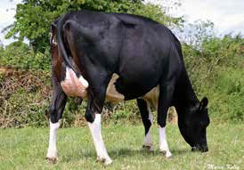
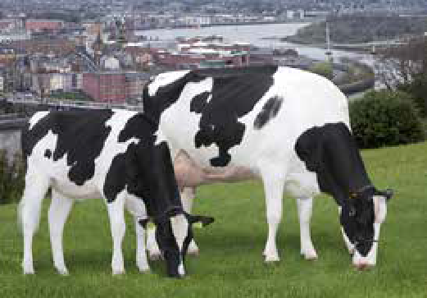
IRISH HOLSTEIN FRIESIAN
LOW GESTATION
HEALTH
COMPS
FERTILITY
HOLSTEIN FRIESIAN
MILK
FERTILITY
HEALTH
HIGH SCI
Kilronan HIGH
Prehen LANCASTER
Dam Kilronan HMY Susie 1112
EBI Data
Source: ICBF Nov 2020
Rel EBI & Sub Indices
Dam and full sister at Prehen, Northern Ireland.
EBI Data
Source: ICBF Nov 2020
P
€
P | € | Rel | EBI & Sub Indices
 |  |  | 0% |  | 25% |  |  | 50% |  |  | 75% |  | 100%
EBI | € 232 | 57%
Milk | € 76 | 73%
Health | € 13 | 68%
Fertility | € 110 | 46%
Calving | € 42 | 65%
Management | -€ 1 | 58%
Maintenance | -€ 5 | 37%
Beef | -€ 3 | 42%
EBI
€ 236
62%
0%
25%
50%
75%
100%
Milk
€ 78
76%
Health
€ 16
63%
Fertility
€ 78
44%
Calving
€ 55
89%
Whisper x Kenny x Rakuna HBN: HOLIRLM222476011495
AI Code: HO5604 Breed: 75% HO 22% FR 3% JE
Dam: Kilronan HMY Susie 1112 2nd Dam: Kilronan Susie 2
3rd Dam: Kilronan Susie
Management
€ 0
54%
Penmanship x Shamrock x Garrett HBN: HOLGBRM954082142776
AI Code: HO4836 Breed: 100% HO
Maintenance
€ 21
50%
Dam: Prehen Shamrock Lady VG88
Beef
-€ 11
66%
2nd Dam: Dipenhoek Model Lady 8 3rd Dam: Comestar Model VG87
SCI & ACI Data
Source: AHDB Dairy-Dec 2020
SCI & ACI Data
Source: AHDB Dairy-Dec 2020
SCI | ACI | Rel %
349 | 408 | 64
Prod Dtrs | 0 | Prod Hrds | 0
SCI | ACI | Rel %
390 | 543 | 66
Prod Dtrs | 0 | Prod Hrds | 0
PRODUCTION
PRODUCTION
Milk Kgs | 51
Fat Kgs | 18.2 | Fat % | 0.28
Protein Kgs | 7.6 | Protein % | 0.1
Milk Kgs | 489
Fat Kgs | 15.7 | Fat % | -0.05
Protein Kgs | 14.9 | Protein % | -0.03
Milk Kgs | Fat Kgs | Protein Kgs | Prod Dtrs
-159 | 15.5 | 3.9 | 0
Rel % | Fat % | Protein % | Prod Hrds
68 | 0.46 | 0.19 | 0
Milk Kgs | Fat Kgs | Protein Kgs | Prod Dtrs
726 | 24.7 | 21.5 | 0
Rel % | Fat % | Protein % | Prod Hrds
69 | -0.11 | -0.06 | 0
HEALTH
HEALTH
Lameness | -0.06 | SCC | -0.1
Mastitis | -0.09 | TB (%) | 6.56
Lameness | -0.04 | SCC | -0.11
Mastitis | -0.06 | TB (%) | 5.9
FERTILITY
FERTILITY
Production and fitness data supplied by AHDB.
Calv. Int (Days) | -4.46 | Survival (%) | 1.75
Production and fitness data supplied by AHDB.
Calv. Int (Days) | -7.2 | Survival (%) | 1.56
SCC | Mastitis | Lameness | Lifespan
-2 | 0 | 1.3 | 85
Fert Index | Maint | TB Adv | D Carcase
8.2 | -6 | 1.5 | 0.1
Calf Surv | DcE | McE | D Dermatitis
1.6 | 1.3 | 0.6 | 0.1
CALVING
SCC | Mastitis | Lameness | Lifespan
-9 | -1 | 2.2 | 94
Fert Index | Maint | TB Adv | D Carcase
12.1 | 9 | 0.8 | 0.5
Calf Surv | DcE | McE | D Dermatitis
2.9 | 0.4 | 1.3 | 0.4
CALVING
Risk of DH Cdiff | Low | McE | 5.83
DcE (Heifers) | 5.14 | Gestation (Days) | -5.41
DcE (Cows) | 2.06 | Mortality | -0.78
Risk of DH Cdiff | Low | McE | 4.93
DcE (Heifers) | 4.72 | Gestation (Days) | -3.13
DcE (Cows) | 1.96 | Mortality | 0.15
MANAGEMENT
MANAGEMENT
Temperament | 0 | Milk Speed | -0.07
Temperament | -0.16 | Milk Speed | -16.62
MAINTENANCE
MAINTENANCE
Stature | -0.75 | Body Condition | -0.11
Stature | 0.26 | Body Condition | -0.3
12|
GENOMIC SIRE
GENOMIC SIRE
|13

Slide 8
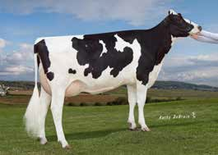
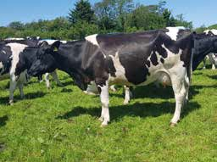
HOLSTEIN FRIESIAN
HIGH EBI
HIGH SCI
HIGH ACI
COMPS
IRISH HOLSTEIN FRIESIAN
NEW FERTILITY
COMPS
HIGH EBI
Pine Tree Lawson LARRY
ONLY AVAILABLE IN
Santry LION KING
COMING SOON
GDam-Endco Yoder L7933 9839 GP83
EBI Data
Source: ICBF Nov 2020
Rel EBI & Sub Indices
Dam Santry Queen 617 VG86
EBI Data
Source: ICBF Nov 2020
Rel EBI & Sub Indices
P
€
P
€
EBI
€ 268
47%
0%
25%
50%
75%
100%
EBI
€ 338
51%
0%
25%
50%
75%
100%
Milk
€ 125
66%
Milk
€ 114
71%
Health
€ 22
61%
Health
€ 9
59%
Fertility
€ 79
35%
Fertility
€ 154
36%
Calving
€ 56
42%
Calving
€ 51
54%
Altalawson x Burley x Yoder HBN: HO840M003150687316
AI Code: HO6348 Breed: 100% HO
Management
€ 2
51%
Pivotal x Harry x OJI Frank HBN: HOIRLM216064121613
AI Code: HO6613 Breed: 84% HO 13% FR 3% UN
Management
€ 10
51%
Dam: Pine-Tree 9839 Burl 7445
Maintenance
-€ 8
31%
Dam: Santry Queen 617 VG86
Maintenance
€ 9
37%
2nd Dam: Endco Yoder L7933 9839 GP83 3rd Dam: T-Spruce Lgold 7933
Beef
-€ 9
32%
2nd Dam: Santry Queen 449 EX90 3rd Dam: Santry Queen 397 VG86
Beef
-€ 8
38%
SCI & ACI Data
Source: AHDB Dairy-Dec 2020
SCI & ACI Data
Source: AHDB Dairy-Dec 2020
SCI | ACI | Rel %
469 | 660 | 63
Prod Dtrs | 0 | Prod Hrds | 0
SCI
ACI
Rel %
Prod Dtrs
0
Prod Hrds
0
PRODUCTION
PRODUCTION
Milk Kgs | 426
Fat Kgs | 29.2 | Fat % | 0.2
Protein Kgs | 17.4 | Protein % | 0.05
Milk Kgs | 180
Fat Kgs | 23.3 | Fat % | 0.28
Protein Kgs | 14 | Protein % | 0.13
Milk Kgs | Fat Kgs | Protein Kgs | Prod Dtrs
622 | 40.8 | 27 | 0
Rel % | Fat % | Protein % | Prod Hrds
67 | 0.25 | 0.1 | 0
SCI | ACI | Rel % | **
SCI | ACI | Rel % | **
HEALTH
HEALTH
Lameness | -0.07 | SCC | -0.21
Mastitis | -0.1 | TB (%) | 5.87
Lameness
-0.05
SCC
-0.02
Mastitis
-0.05
TB (%)
7.76
FERTILITY
FERTILITY
Production and fitness data supplied by AHDB.
Calv. Int (Days) | -4.57 | Survival (%) | 1.76
Production and fitness data supplied by AHDB.
Calv. Int (Days) | -8.98 | Survival (%) | 3.3
SCC | Mastitis | Lameness | Lifespan
-12 | -1 | 2.8 | 88
Fert Index | Maint | TB Adv | D Carcase
8.1 | 25 | 1.2 | 0.5
Calf Surv | DcE | McE | D Dermatitis
2.3 | 0 | 0.9 | 0.3
CALVING
SCI
ACI
Rel %
**
CALVING
Risk of DH Cdiff | Low | McE | 4.66
DcE (Heifers) | 5.75 | Gestation (Days) | -5.28
DcE (Cows) | 2.4 | Mortality | -0.08
Risk of DH Cdiff
Low
McE
5.02
DcE (Heifers)
5.28
Gestation (Days)
-4.33
SCI
ACI
Rel %
**
DcE (Cows)
2.06
Mortality
-0.33
MANAGEMENT
MANAGEMENT
Temperament | -0.2 | Milk Speed | -30.07
SCI
ACI
Rel %
Rel %
Temperament
0.06
Milk Speed
-23.72
MAINTENANCE
MAINTENANCE
Stature | 2.04 | Body Condition | -0.8
Stature | 0.21 | Body Condition | 1.39
14|
GENOMIC SIRE
GENOMIC SIRE
|15

Slide 9
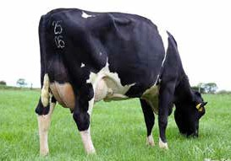
IRISH HOLSTEIN FRIESIAN
COMPS
LOW CALVING
GESTATION EASE
STATURE
IRISH HOLSTEIN FRIESIAN
COMPS
FERTILITY
HIGH EBI
STATURE
Kildarra MAESTRO
Bridepark MAGIC
Dam Modeligo WPE May VG86
EBI Data
Source: ICBF Nov 2020
Family Member Bridepark AKZ Karen
EBI Data
Source: ICBF Nov 2020
P | € | Rel | EBI & Sub Indices
 |  |  | 0% |  | 25% |  |  | 50% |  |  | 75% |  | 100%
EBI | € 231 | 95%
Milk | € 106 | 99%
Health | -€ 5 | 94%
Fertility | € 60 | 89%
Calving | € 57 | 98%
Management | € 7 | 80%
Maintenance | € 11 | 98%
Beef | -€ 5 | 99%
P | € | Rel | EBI & Sub Indices
 |  |  | 0% |  | 25% |  |  | 50% |  |  | 75% |  | 100%
EBI | € 280 | 59%
Milk | € 103 | 76%
Health | € 12 | 62%
Fertility | € 126 | 43%
Calving | € 43 | 77%
Management | -€ 2 | 55%
Maintenance | € 21 | 42%
Beef | -€ 21 | 44%
Lucky Whistler x Eckland x Jordanaire HBN: HOLIRLM141518921049
AI Code: HO4745 Breed: 66% HO 34% FR
Absolute x Lamont x Supersonic HBN: HOIRLM216818220984
AI Code: HO6120 Breed: 75% HO 22% FR 3% JE
Dam: Modeligo WPE May VG86
Dam: Bridepark MSF Karen 0844
2nd Dam: Modeligo CWJ May 1506 F73 3rd Dam: Laha CBH May 1106
2nd Dam: Bridepark Karen WDS 682 3rd Dam: Bridepark BWZ Karen 412
SCI & ACI Data
Source: AHDB Dairy-Dec 2020
SCI & ACI Data
Source: AHDB Dairy-Dec 2020
SCI | ACI | Rel %
180 | 201 | 83
Prod Dtrs | 3947 | Prod Hrds | 858
SCI | ACI | Rel %
228 | 254 | 64
Prod Dtrs | 0 | Prod Hrds | 0
PRODUCTION
PRODUCTION
Milk Kgs | 85
Fat Kgs | 18.3 | Fat % | 0.26
Protein Kgs | 12.9 | Protein % | 0.17
Milk Kgs | 174
Fat Kgs | 13 | Fat % | 0.11
Protein Kgs | 15.5 | Protein % | 0.16
Milk Kgs | Fat Kgs | Protein Kgs | Prod Dtrs
-70 | 9 | 6.8 | 15
Rel % | Fat % | Protein % | Prod Hrds
87 | 0.24 | 0.18 | 2
Milk Kgs | Fat Kgs | Protein Kgs | Prod Dtrs
-70 | 0.5 | 6.8 | 0
Rel % | Fat % | Protein % | Prod Hrds
67 | 0.07 | 0.18 | 0
HEALTH
HEALTH
Lameness | -0.01 | SCC | 0.12
Mastitis | 0.01 | TB (%) | 10.7
Lameness | -0.06 | SCC | -0.07
Mastitis | -0.05 | TB (%) | 5.82
FERTILITY
FERTILITY
Production and fitness data supplied by AHDB.
Calv. Int (Days) | -3.92 | Survival (%) | 0.88
Production and fitness data supplied by AHDB.
Calv. Int (Days) | -8.63 | Survival (%) | 1.36
SCC | Mastitis | Lameness | Lifespan
17 | 2 | -1.4 | 18
Fert Index | Maint | TB Adv | D Carcase
5.8 | 7 | -0.2 | 1.5
Calf Surv | DcE | McE | D Dermatitis
-1.7 | 1.9 | 0.7 | -0.2
CALVING
SCC | Mastitis | Lameness | Lifespan
1 | 0 | 0.3 | 45
Fert Index | Maint | TB Adv | D Carcase
2.7 | -2 | 0.5 | -0.1
Calf Surv | DcE | McE | D Dermatitis
2.6 | 1.2 | 0.4 | 0
CALVING
Risk of DH Cdiff | Low | McE | 4.76
DcE (Heifers) | 5.57 | Gestation (Days) | -5.14
DcE (Cows) | 2.33 | Mortality | -0.6
Risk of DH Cdiff | Moderate | McE | 5.04
DcE (Heifers) | 8.02 | Gestation (Days) | -5.13
DcE (Cows) | 3.09 | Mortality | -0.54
MANAGEMENT
MANAGEMENT
Temperament | 0.03 | Milk Speed | -20.35
Temperament | -0.11 | Milk Speed | -6.17
MAINTENANCE
MAINTENANCE
Stature | -1.26 | Body Condition | 0.13
Stature | -1.19 | Body Condition | 0.64
16|
PROVEN SIRE
GENOMIC SIRE
|17

Slide 10
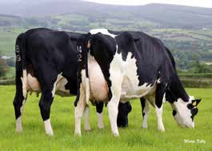
IRISH HOLSTEIN FRIESIAN
NEW
CALVING HIGH
EASE EBI
COMPS
IRISH HOLSTEIN FRIESIAN
COMPS
FERTILITY
HIGH EBI
STATURE
Hanrahan MAGNIFICO
COMING SOON
Kildarra MAJOR
ONLY AVAILABLE IN
Dam & Gdam of Hanrahan Magnifico
EBI Data
Source: ICBF Nov 2020
Rel EBI & Sub Indices
Dam Modeligo WPE May VG86
EBI Data
Source: ICBF Nov 2020
P
€
P | € | Rel | EBI & Sub Indices
 |  |  | 0% |  | 25% |  |  | 50% |  |  | 75% |  | 100%
EBI | € 278 | 61%
Milk | € 87 | 77%
Health | € 1 | 64%
Fertility | € 140 | 46%
Calving | € 45 | 82%
Management | € 6 | 56%
Maintenance | € 14 | 45%
Beef | -€ 14 | 50%
EBI
€ 306
51%
0%
25%
50%
75%
100%
Milk
€ 123
72%
Health
€ 18
60%
Fertility
€ 99
35%
Calving
€ 65
50%
Pivotal x Interstice x Cremin HBN: HOIRLM213675211055
AI Code: HO6605 Breed: 88% HO 12% FR
Management
€ 7
52%
Boycie x Eckland x Jordanaire HBN: HOIRLM213434061525
AI Code: HO6118 Breed: 78% HO 22% FR
Dam: Hanrahan S2304 Maureen VG87
Maintenance
€ 7
42%
Dam: Modeligo WPE May VG86
2nd Dam: Hanrahan DGC Maureen EX90 3rd Dam: Hanrahan Uphill Maureen G79
Beef
-€ 12
39%
2nd Dam: Modeligo CWJ May 1506 F73 3rd Dam: Laha CBH May 1106
SCI & ACI Data
Source: AHDB Dairy-Dec 2020
SCI & ACI Data
Source: AHDB Dairy-Dec 2020
SCI
ACI
Rel %
Prod Dtrs | 0 | Prod Hrds | 0
SCI | ACI | Rel %
285 | 321 | 64
Prod Dtrs | 0 | Prod Hrds | 0
PRODUCTION
PRODUCTION
Milk Kgs | 212
Fat Kgs | 24.3 | Fat % | 0.27
Protein Kgs | 15.5 | Protein % | 0.14
Milk Kgs | 70
Fat Kgs | 14.7 | Fat % | 0.21
Protein Kgs | 10.6 | Protein % | 0.14
SCI | ACI | Rel % | **
SCI | ACI | Rel % | **
Milk Kgs | Fat Kgs | Protein Kgs | Prod Dtrs
-200 | 0.5 | 3.5 | 0
Rel % | Fat % | Protein % | Prod Hrds
67 | 0.19 | 0.21 | 0
HEALTH
HEALTH
Lameness | -0.11 | SCC | -0.06
Mastitis | -0.09 | TB (%) | 8.29
Lameness | -0.02 | SCC | 0.02
Mastitis | 0 | TB (%) | 8.1
FERTILITY
FERTILITY
Production and fitness data supplied by AHDB.
Calv. Int (Days) | -5.02 | Survival (%) | 2.91
Production and fitness data supplied by AHDB.
Calv. Int (Days) | -9.09 | Survival (%) | 2.08
SCI | ACI | Rel % | **
SCI | ACI | Rel % | **
SCI | ACI | Rel % | Rel %
CALVING
SCC | Mastitis | Lameness | Lifespan
2 | -1 | 0 | 85
Fert Index | Maint | TB Adv | D Carcase
8.2 | -9 | -0.2 | 0.3
Calf Surv | DcE | McE | D Dermatitis
2.2 | 1.6 | 0.5 | -0.3
CALVING
Risk of DH Cdiff | Low | McE | 4.5
DcE (Heifers) | 2.83 | Gestation (Days) | -5.03
DcE (Cows) | 1.72 | Mortality | -0.23
Risk of DH Cdiff | Moderate | McE | 5.59
DcE (Heifers) | 6.7 | Gestation (Days) | -4.86
DcE (Cows) | 2.51 | Mortality | -0.14
MANAGEMENT
MANAGEMENT
Temperament | 0.04 | Milk Speed | -16.51
Temperament | 0.14 | Milk Speed | -3.95
MAINTENANCE
MAINTENANCE
Stature | -0.47 | Body Condition | 0.31
Stature | -0.93 | Body Condition | -0.01
18|
GENOMIC SIRE
GENOMIC SIRE
|19

Slide 11
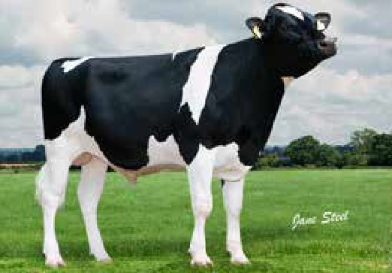
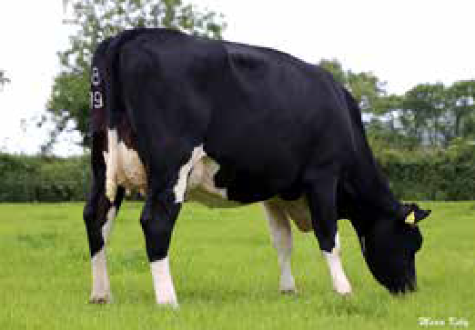
IRISH HOLSTEIN FRIESIAN
COMPS
FERTILITY
HIGH EBI
LAMENESS
IRISH HOLSTEIN FRIESIAN
COMPS
HEALTH
CALVING EASE
MILK
Munta MYSTIC
Hanrahan OLYMPUS
EBI Data
Source: ICBF Nov 2020
Dam Hanrahan S2304 Maureen VG87
EBI Data
Source: ICBF Nov 2020
Rel EBI & Sub Indices
P | € | Rel | EBI & Sub Indices
 |  |  | 0% |  | 25% |  |  | 50% |  |  | 75% |  | 100%
EBI | € 296 | 55%
Milk | € 106 | 74%
Health | € 13 | 61%
Fertility | € 138 | 43%
Calving | € 48 | 54%
Management | -€ 4 | 52%
Maintenance | € 11 | 42%
Beef | -€ 16 | 43%
P
€
EBI
€ 253
60%
0%
25%
50%
75%
100%
Milk
€ 113
77%
Health
€ 18
66%
Fertility
€ 77
44%
Calving
€ 46
79%
Mystic x Rudolph x Glen HBN: HOIRLM213326514022
AI Code: HO6152 Breed: 94% HO 6% FR
Sebastain x Interstice x Cremin HBN: HOIRLM213675260953
AI Code: HO6121 Breed: 91% HO 9% FR
Management
€ 0
56%
Dam: Munta Jackie Mag 37 GP82
Dam: Hanrahan S2304 Maureen VG87
Maintenance
€ 4
49%
2nd Dam: Munta Jackie Mag 34 EX90 3rd Dam: Munta Jackie Mag 32
2nd Dam: Hanrahan DGC Maureen EX90 3rd Dam: Hanrahan Uphill Maureen G79
Beef
-€ 5
48%
SCI & ACI Data
Source: AHDB Dairy-Dec 2020
SCI & ACI Data
Source: AHDB Dairy-Dec 2020
SCI | ACI | Rel %
343 | 445 | 65
Prod Dtrs | 0 | Prod Hrds | 0
SCI | ACI | Rel %
287 | 388 | 63
Prod Dtrs | 0 | Prod Hrds | 0
PRODUCTION
PRODUCTION
Milk Kgs | 275
Fat Kgs | 20.6 | Fat % | 0.16
Protein Kgs | 15 | Protein % | 0.09
Milk Kgs | 288
Fat Kgs | 23.9 | Fat % | 0.21
Protein Kgs | 15.1 | Protein % | 0.09
Milk Kgs | Fat Kgs | Protein Kgs | Prod Dtrs
198 | 17.3 | 13.4 | 0
Rel % | Fat % | Protein % | Prod Hrds
68 | 0.17 | 0.13 | 0
Milk Kgs | Fat Kgs | Protein Kgs | Prod Dtrs
296 | 21.1 | 16.7 | 0
Rel % | Fat % | Protein % | Prod Hrds
66 | 0.16 | 0.12 | 0
HEALTH
HEALTH
Lameness | -0.09 | SCC | -0.05
Mastitis | -0.05 | TB (%) | 6.93
Lameness | -0.08 | SCC | -0.15
Mastitis | -0.07 | TB (%) | 7.73
FERTILITY
FERTILITY
Production and fitness data supplied by AHDB.
Calv. Int (Days) | -7.44 | Survival (%) | 3.6
Production and fitness data supplied by AHDB.
Calv. Int (Days) | -3.57 | Survival (%) | 2.55
SCC | Mastitis | Lameness | Lifespan
-5 | -1 | 0.6 | 85
Fert Index | Maint | TB Adv | D Carcase
7.7 | 4 | 1 | -0.2
Calf Surv | DcE | McE | D Dermatitis
2.7 | 0.8 | 0.8 | -0.1
CALVING
SCC | Mastitis | Lameness | Lifespan
-6 | 0 | 2.4 | 64
Fert Index | Maint | TB Adv | D Carcase
2.9 | 13 | -0.4 | 0.9
Calf Surv | DcE | McE | D Dermatitis
0.3 | 1.2 | 0.5 | 0.4
CALVING
Risk of DH Cdiff | Moderate | McE | 5.12
DcE (Heifers) | 7.55 | Gestation (Days) | -4.66
DcE (Cows) | 2.27 | Mortality | -0.82
Risk of DH Cdiff | Low | McE | 5.38
DcE (Heifers) | 3.84 | Gestation (Days) | -3.88
DcE (Cows) | 2.07 | Mortality | 0.17
MANAGEMENT
MANAGEMENT
Temperament | -0.13 | Milk Speed | -2.62
Temperament | -0.01 | Milk Speed | -0.3
MAINTENANCE
MAINTENANCE
Stature | 0.14 | Body Condition | -0.33
Stature | -0.07 | Body Condition | -0.03
20|
GENOMIC SIRE
GENOMIC SIRE
|21

Slide 12
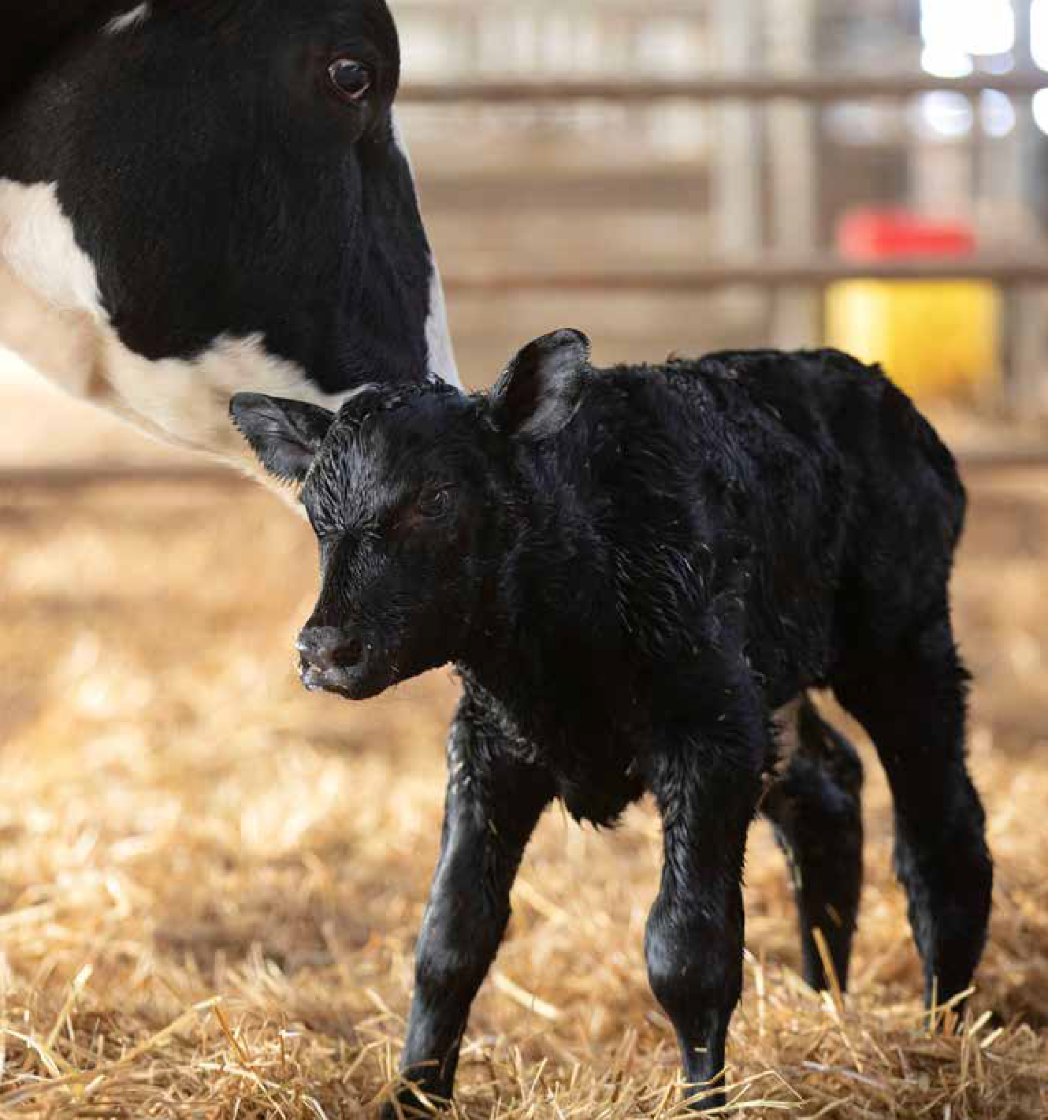
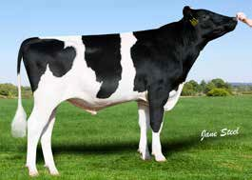

HP
HOLSTEIN FRIESIAN
CALVING HIGH
EASE SCI
HIGH ACI
HEALTH
Wiltor PORTER
EBI Data
Source: ICBF Nov 2020
Rel EBI & Sub Indices
P
€
EBI
€ 252
54%
0%
25%
50%
75%
100%
Milk
€ 109
72%
Health
€ 28
64%
Fertility
€ 64
42%
Calving
€ 58
52%
Perseus x Supershot x Massey HBN: HOGBRM727942100444
AI Code: HO5612 Breed: 100% HO
Dam: Peak Wiltor Missy VG85 2nd Dam: RZN Shila
Management
€ 2
54%
Maintenance
-€ 8
37%
3rd Dam: Ms Moviestar Shaker VG85
Beef
-€ 1
43%
SCI & ACI Data
Source: AHDB Dairy-Dec 2020
SCI | ACI | Rel %
428 | 584 | 65
Prod Dtrs | 0 | Prod Hrds | 0
PRODUCTION
Milk Kgs | 570
Fat Kgs | 17 | Fat % | -0.08
Protein Kgs | 21.2 | Protein % | 0.03
Milk Kgs | Fat Kgs | Protein Kgs | Prod Dtrs
673 | 23.7 | 24.8 | 0
Rel % | Fat % | Protein % | Prod Hrds
69 | -0.08 | 0.03 | 0
HEALTH
Lameness | -0.05 | SCC | -0.32
Mastitis | -0.13 | TB (%) | 3.59
FERTILITY
CALVING
AHDB.
by
supplied data
fitness and
Production
^{22|} GENOMIC SIRE
Production and fitness data supplied by AHDB.
Calv. Int (Days) | -2.99 | Survival (%) | 2.1
The release of our financial index in the form of the COGENT BEEF IMPACT (£CBI) is aimed at customers wanting to find bulls that will suit their systems for Ease of Management and added Market Value.
For more information contact your local Genetic Consultant.
SCC | Mastitis | Lameness | Lifespan
-32 | -4 | 0.8 | 106
Fert Index | Maint | TB Adv | D Carcase
6.2 | 13 | 2.3 | 1.6
Calf Surv | DcE | McE | D Dermatitis
1.3 | 0.5 | 1.5 | -0.3
Risk of DH Cdiff | Low | McE | 4.83
DcE (Heifers) | 4.98 | Gestation (Days) | -5.14
DcE (Cows) | 2.17 | Mortality | -0.38
MANAGEMENT
Temperament | -0.07 | Milk Speed | -15.95
MAINTENANCE
Stature | 0.08 | Body Condition | 1.39
GENOMIC SIRE
|23

Slide 13
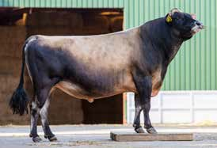
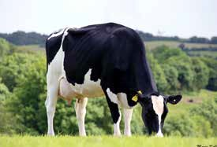
IRISH JERSEY
COMPS
MAINTENANCE
STATURE
CALVING EASE
IRISH HOLSTEIN FRIESIAN
SCC
COMPS
FERTILITY
CALVING EASE
Nextgen Lurik RICKI
Curra SALAH
EBI Data
Source: ICBF Nov 2020
Rel EBI & Sub Indices
DAM CURRA WDS TULIP 2 GP83
EBI Data
Source: ICBF Nov 2020
P
€
P | € | Rel | EBI & Sub Indices
 |  |  | 0% |  | 25% |  |  | 50% |  |  | 75% |  | 100%
EBI | € 251 | 62%
Milk | € 80 | 78%
Health | € 9 | 68%
Fertility | € 124 | 46%
Calving | € 43 | 84%
Management | € 0 | 58%
Maintenance | € 8 | 50%
Beef | -€ 14 | 50%
EBI
€ 154
55%
0%
25%
50%
75%
100%
Milk
€ 54
74%
Health
€ 10
64%
Fertility
€ 40
40%
Calving
€ 31
56%
Lurik x Forever Sam x Likabull HBN: JERIRLM151941630947
AI Code: J2663 Breed: 100% JE
Management
€ 8
60%
Candy x Kenny x O-Man
HBN: HOLIRLM222458222409
AI Code: HO5939 Breed: 75% HO 22% FR 3% MO
Dam: Curra WDS Tulip 2 GP83 2nd Dam: Curra OJI Tulip 2 3rd Dam: Curra BWZ Tulip
Dam: IE151828721892
Maintenance
€ 62
47%
2nd Dam: Ballyhooly Likabull Keelen 3rd Dam: Hillstar Sams Janette
Beef
-€ 51
44%
SCI & ACI Data
Source: AHDB Dairy-Dec 2020
SCI & ACI Data
Source: AHDB Dairy-Dec 2020
SCI | ACI | Rel %
270 | 258 | 58
Prod Dtrs | 0 | Prod Hrds | 0
SCI | ACI | Rel %
300 | 344 | 64
Prod Dtrs | 0 | Prod Hrds | 0
PRODUCTION
PRODUCTION
Milk Kgs | -473
Fat Kgs | 15.4 | Fat % | 0.64
Protein Kgs | -3.6 | Protein % | 0.24
Milk Kgs | 38
Fat Kgs | 14.3 | Fat % | 0.22
Protein Kgs | 9.2 | Protein % | 0.14
Milk Kgs | Fat Kgs | Protein Kgs | Prod Dtrs
-530 | 4.5 | -7.4 | 0
Rel % | Fat % | Protein % | Prod Hrds
60 | 0.6 | 0.24 | 0
Milk Kgs | Fat Kgs | Protein Kgs | Prod Dtrs
-118 | 6.8 | 5.7 | 0
Rel % | Fat % | Protein % | Prod Hrds
67 | 0.24 | 0.2 | 0
HEALTH
HEALTH
Lameness | -0.07 | SCC | -0.08
Mastitis | -0.02 | TB (%) | 4.41
Lameness | -0.02 | SCC | -0.12
Mastitis | -0.03 | TB (%) | 10.08
FERTILITY
FERTILITY
Production and fitness data supplied by AHDB.
Calv. Int (Days) | -1.14 | Survival (%) | 2.1
Production and fitness data supplied by AHDB.
Calv. Int (Days) | -7.2 | Survival (%) | 2.69
SCC | Mastitis | Lameness | Lifespan
0 | N/A | N/A | 57
Fert Index | Maint | TB Adv | D Carcase
5.9 | -60 | N/A | N/A
Calf Surv | DcE | McE | D Dermatitis
N/A | N/A | N/A | N/A
CALVING
SCC | Mastitis | Lameness | Lifespan
-3 | -1 | 0.6 | 82
Fert Index | Maint | TB Adv | D Carcase
7.9 | 1 | 1.4 | -0.7
Calf Surv | DcE | McE | D Dermatitis
0.6 | 1.8 | 0.9 | 0.2
CALVING
Risk of DH Cdiff | Low | McE | 5.67
DcE (Heifers) | 2.11 | Gestation (Days) | -1.63
DcE (Cows) | 1.43 | Mortality | 0.76
Risk of DH Cdiff | Low | McE | 5.34
DcE (Heifers) | 4.4 | Gestation (Days) | -3.41
DcE (Cows) | 2.2 | Mortality | -0.78
MANAGEMENT
MANAGEMENT
Temperament | 0.18 | Milk Speed | -6.4
Temperament | -0.14 | Milk Speed | -15.6
MAINTENANCE
MAINTENANCE
Stature | -2.23 | Body Condition | -1.65
Stature | -0.56 | Body Condition | 1.26
24|
GENOMIC SIRE
GENOMIC SIRE
|25

Slide 14
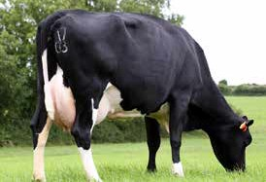
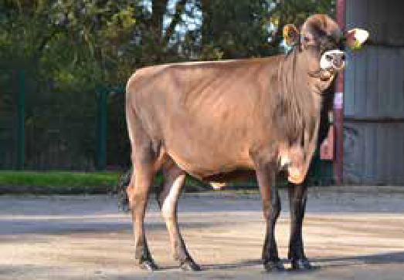
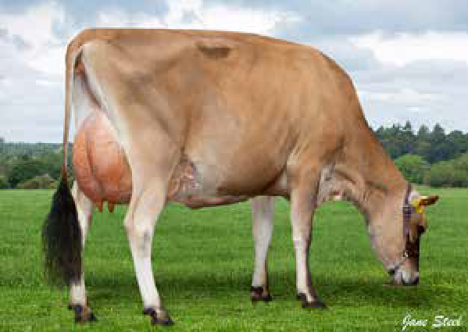
IRISH HOLSTEIN FRIESIAN
NEW HIGH EBI
FERTILITY
COMPS
JERSEY
LIFESPAN
COMPS
STATURE
MAMMARY
Cillwalsh WONDER
COMING SOON
Thurlstone BANGING
HIGH
HIGH
PURITY
PURITY
Dam Cillwalsh Weary 13
EBI Data
Source: ICBF Nov 2020
Dam Thurlstone Chrome Bluebell GP82
P | € | Rel | EBI & Sub Indices
 |  |  | 0% |  | 25% |  |  | 50% |  |  | 75% |  | 100%
EBI | € 292 | 51%
Milk | € 86 | 71%
Health | € 13 | 58%
Fertility | € 144 | 36%
Calving | € 45 | 52%
Management | € 3 | 50%
Maintenance | € 10 | 38%
Beef | -€ 10 | 40%
Katman x Taurus x Merci 5 HBN: HOIRLM217532162149
AI Code: HO6597 Breed: 81% HO 19% FR
Sirestack Channing x Chrome x Zik HBN: JERGBRM141840302856
AI Code: J2684 Breed: 100% JE
Dam: Thurlstone Chrome Bluebell GP82 2nd Dam: Thurlstone Zik Bluebell EX91 3rd Dam: Thurlstone Abe Bluebell VG86
Dam: Cillwalsh Weary 13
2nd Dam: Cillwalsh MTZ Weary 3rd Dam: Cillwalsh UYC Weary
SCI & ACI Data
Source: AHDB Dairy-Dec 2020
SCI & ACI Data
Source: AHDB Dairy-Dec 2020
SCI
ACI
Rel %
Prod Dtrs | 0 | Prod Hrds | 0
SCI | ACI | Rel %
273 | 357 | 57
-2
-1
0
1
2
PRODUCTION
UK Type Merit 1 |  |  | Excellent
UK Udder Comp 1.6 |  |  | Excellent
UK Feet and Legs 0.80 |  |  | Excellent
Stature 1.4 |  |  | Taller
Chest Width -0.1 |  |  | Narrow
Body Depth 0.9 |  |  | Deep
Angularity Rump Angle |  | 2.3 | Open Rib
 |  | 0.8 | Lower
Rump Width |  | 0.3 | Wide
Rear Leg Side 0.2 |  |  | Sickled
Foot Angle 0.4 |  |  | Steep
F.Udder Attach 0.2 |  |  | Tight
R. Udder Height 2.1 |  |  | Very High
Udder Support 1.5 |  |  | Strong
Udder Depth 0.1 |  |  | Shallow
F.Teat Placement | 0.4 |  | Close
Teat Length | -0.4 |  | Shorter
R.Teat Placement | N/A |  | Close
Teat Pos Side | N/A |  | Apart
Locomotion |  | 0.6 | Excellent
Milk Kgs | 23
Fat Kgs | 14.2 | Fat % | 0.23
Protein Kgs | 10 | Protein % | 0.16
SCI | ACI | Rel % | **
SCI | ACI | Rel % | **
Milk Kgs | Fat Kgs | Protein Kgs | Prod Dtrs
-21 | 24.2 | 7.7 | 0
Rel % | Fat % | Protein % | Prod Hrds
59 | 0.5 | 0.17 | 0
HEALTH
Lameness | -0.05 | SCC | -0.05
Mastitis | -0.09 | TB (%) | 9.44
FERTILITY
CALVING
Production and fitness data supplied by AHDB.
Calv. Int (Days) | -9.02 | Survival (%) | 2.43
Production and fitness data supplied by AHDB.
SCI | ACI | Rel % | **
SCI | ACI | Rel % | **
SCI | ACI | Rel % | Rel %
SCC | Mastitis | Lameness | Lifespan
-1 | N/A | N/A | 93
Fert Index | Maint | TB Adv | D Carcase
-0.3 | -51 | N/A | N/A
Calf Surv | DcE | McE | D Dermatitis
N/A | N/A | N/A | N/A
Risk of DH Cdiff | Low | McE | 5.29
DcE (Heifers) | 3.21 | Gestation (Days) | -3.23
DcE (Cows) | 2.02 | Mortality | -0.47
MANAGEMENT
Temperament | 0.01 | Milk Speed | -9.99
Daughters in Herds | 0 Dtrs 0 Herds 61% Rel
TYPE DATA SUPPLIED BY HOLSTEIN UK SOURCE: HOLSTEIN UK – DEC 2020
MAINTENANCE
Stature | -0.79 | Body Condition | 1.85
26|
GENOMIC SIRE
GENOMIC SIRE
|27

Slide 15
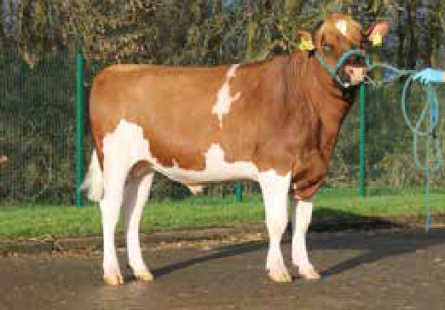
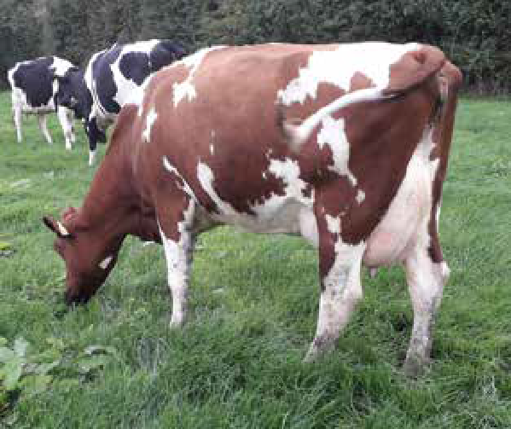
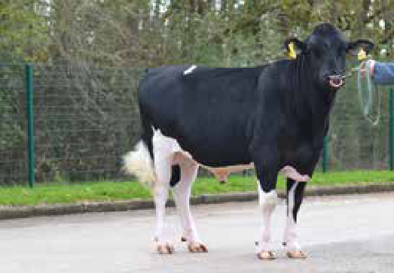

BRITISH FRIESIAN
FERTILITY
COMPS
STATURE
CALVING EASE
BRITISH FRIESIAN
FERTILITY
COMPS
LIFESPAN
CALVING EASE
Inch BENNY RED
Inch BRILLIANT
HIGH
PURITY
Dam Inch Evolution Daphne Red VG88
The Supreme Grazing Friesian-Excellent Longevity, High Fertility, Great Components and Easy Calving.
Benloyal x Evolution x Glenalbyn HBN: BRFGBRM937005758792
AI Code: BF1177 Breed: 95% FR 5% HO
Bryster x Tarquin x Glenalbyn HBN: BFGBRM937005761684
AI Code: BF1191 Breed: 91% FR 9% HO
Dam: Inch Evolution Daphne Red BFV88
Dam: Inch Tarquin Daphne 4 BFV85
2nd Dam: Inch Blackisle Daphne 2 EX92 5E 3rd Dam: Inch Sem Daphne 2 VG88
2nd Dam: Inch Blackisle Daphne 2 EX92(5) 3rd Dam: Inch Sem Daphne 2 VG88
SCI & ACI Data
Source: AHDB Dairy-Dec 2020
SCI & ACI Data
Source: AHDB Dairy-Dec 2020
-2
-1
0
1
2
SCI | ACI | Rel %
338 | 323 | 66
-2
-1
0
1
2
SCI | ACI | Rel %
345 | 379 | 64
UK Type Merit |  |  |  | 0.64 | Excellent
UK Udder Comp |  |  |  | 0.69 | Excellent
UK Feet and Legs |  |  |  | 0.47 | Excellent
Stature |  |  |  | 0.91 | Taller
Chest Width |  | 0.56 |  |  | Wide
Body Depth |  |  | 0.64 |  | Deep
Angularity |  |  | 0.91 |  | Open Rib
Rump Angle |  |  | 0.11 |  | Lower
Rump Width |  |  | 0.34 |  | Wide
Rear Leg Side |  |  | -0.59 |  | Straight
Foot Angle |  |  | -0.07 |  | Low
F.Udder Attach |  |  | -0.34 |  | Loose
R. Udder Height |  |  |  | 0.65 | Very High
Udder Support |  |  |  | 0.74 | Strong
Udder Depth |  |  |  | -0.44 | Deep
F.Teat Placement |  |  |  | -0.32 | Outside
Teat Length |  |  |  | 0.94 | Longer
R.Teat Placement |  |  |  | 0.6 | Close
Teat Pos Side |  |  |  | 1.13 | Apart
Locomotion |  |  |  | 0.56 | Excellent
UK Type Merit |  | 1.31 | Excellent
UK Udder Comp |  | 1.32 | Excellent
UK Feet and Legs |  | 0.82 | Excellent
Stature | -0.92 |  | Shorter
Chest Width | -0.32 |  | Narrow
Body Depth | -0.82 |  | Shallow
Angularity | 0.06 |  | Open Rib
Rump Angle |  | -0.42 | Higher
Rump Width | 0.06 |  | Wide
Rear Leg Side | -0.21 |  | Straight
Foot Angle |  | -0.01 | Low
F.Udder Attach |  | 0.85 | Tight
R. Udder Height |  | 1.31 | Very High
Udder Support |  | 0.81 | Strong
Udder Depth |  | 0.7 | Shallow
F.Teat Placement |  | 1.09 | Close
Teat Length |  | -0.18 | Shorter
R.Teat Placement |  | 0.61 | Close
Teat Pos Side |  | 0.65 | Apart
Locomotion |  | 0.63 | Excellent
Milk Kgs | Fat Kgs | Protein Kgs | Prod Dtrs
-318 | -4.8 | -8.5 | 0
Rel % | Fat % | Protein % | Prod Hrds
69 | 0.18 | 0.05 | 0
Milk Kgs | Fat Kgs | Protein Kgs | Prod Dtrs
-100 | 0.4 | 2.3 | 0
Rel % | Fat % | Protein % | Prod Hrds
67 | 0.09 | 0.12 | 0
Production and fitness data supplied by AHDB.
SCC | Mastitis | Lameness | Lifespan
0 | -2 | -0.4 | 112
Fert Index | Maint | TB Adv | D Carcase
12.8 | -17 | 3.4 | 1.3
Calf Surv | DcE | McE | D Dermatitis
2.3 | 1.4 | 0.1 | 0
Production and fitness data supplied by AHDB.
SCC | Mastitis | Lameness | Lifespan
-2 | -2 | -1 | 118
Fert Index | Maint | TB Adv | D Carcase
9.7 | 0 | 0.9 | 2.7
Calf Surv | DcE | McE | D Dermatitis
2.6 | 1 | -0.4 | 0.1
Daughters in Herds | 0 Dtrs 0 Herds 58% Rel
Daughters in Herds | 0 Dtrs 0 Herds 53% Rel
TYPE DATA SUPPLIED BY HOLSTEIN UK SOURCE: HOLSTEIN UK – DEC 2020
TYPE DATA SUPPLIED BY HOLSTEIN UK SOURCE: HOLSTEIN UK – DEC 2020
28|
GENOMIC SIRE
GENOMIC SIRE
|29

Slide 16
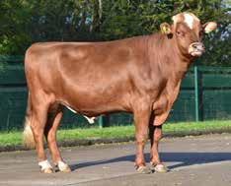
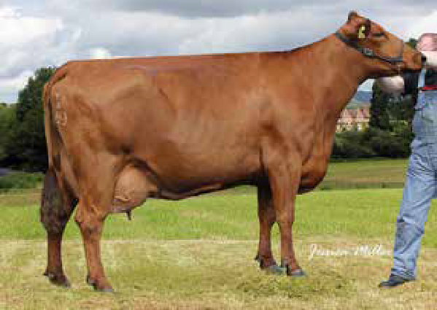
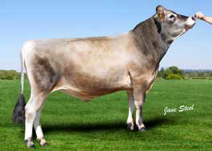
SCANDINAVIAN RED
FERTILITY
MILK
MAINTENANCE
A2A2
JERSEY
LIFESPAN
COMPS MAINTENANCE FERTILITY
Wyevalley FORTUNE
Grahams GOLDTOP
HIGH
HIGH
PURITY
PURITY
Dam Skyhigh Bangkok Andera EX93 3E
Goldtop provides the blend of Components and Fertility that everyone wants.
Fenton x R Bangkok x R Ascona HBN: AYGBRM000008000238
AI Code: SR2067 Breed: 28% AY 72% SR
Dam: Skyhigh Bangkok Andera EX93 3E 2nd Dam: Andora
3rd Dam: DK02380801861
Dillan P x Dimension x Impuls HBN: JERGBRM543178402906
AI Code: J2590 Breed: 100% JE
Dam: Sunset Canyon Dimension Maid 153
2nd Dam: Sunset Canyon Impuls L Maid 4 EX91 3rd Dam: Sunset Canyon Lemvig Maid 4 EX93
SCI & ACI Data
Source: AHDB Dairy-Dec 2020
SCI & ACI Data
Source: AHDB Dairy-Dec 2020
-2
-1
0
1
2
SCI | ACI | Rel %
88 | 113 | 42
-2
UK Type Merit
-1
0
1
2
1
Excellent
SCI | ACI | Rel %
302 | 363 | 58
UK Type Merit | 0.2 | Excellent
UK Udder Comp | 0.1 | Excellent
UK Feet and Legs | 0.30 | Excellent
Stature | 1.2 | Taller
Chest Width | -0.7 | Narrow
Body Depth | -0.2 | Average
Angularity | 1 | Open Rib
Rump Angle | 1.6 | Lower
Rump Width | 0.5 | Wide
Rear Leg Side | 0.1 | Sickled
Foot Angle | 0.7 | Steep
F.Udder Attach | -0.1 | Loose
R. Udder Height | 0.7 | Very High
Udder Support | -0.6 | Broken
Udder Depth | -0.1 | Deep
F.Teat Placement | -0.1 | Outside
Teat Length | 0.7 | Longer
R.Teat Placement | N/A | Close
Teat Pos Side | N/A | Apart
Locomotion | -0.6 | Poor
UK Udder Comp
0.2 Excellent
1.10 Excellent
UK Feet and Legs
0.3 Taller
-0.7 Narrow
Stature
Milk Kgs | Fat Kgs | Protein Kgs | Prod Dtrs
146 | 1.5 | 3.5 | 0
Rel % | Fat % | Protein % | Prod Hrds
43 | -0.09 | -0.03 | 0
Chest Width
-0.8 Shallow
-0.3 Coarse
Milk Kgs | Fat Kgs | Protein Kgs | Prod Dtrs
-129 | 17.4 | 5.1 | 0
Rel % | Fat % | Protein % | Prod Hrds
59 | 0.47 | 0.19 | 0
Body Depth
Angularity
-0.1 Higher
-0.4 Narrow
Rump Angle
Rump Width
-0.2 Straight
1.6 Steep
Rear Leg Side
Foot Angle
-0.4 Loose
-0.1 Very Low
F.Udder Attach
Production and fitness data supplied by AHDB.
SCC | Mastitis | Lameness | Lifespan
3 | N/A | N/A | 33
Fert Index | Maint | TB Adv | D Carcase
5.5 | -12 | N/A | N/A
Calf Surv | DcE | McE | D Dermatitis
N/A | N/A | N/A | N/A
R. Udder Height
-0.1 Broken
0.1 Shallow
Production and fitness data supplied by AHDB.
SCC | Mastitis | Lameness | Lifespan
4 | N/A | N/A | 93
Fert Index | Maint | TB Adv | D Carcase
5.5 | -52 | N/A | N/A
Calf Surv | DcE | McE | D Dermatitis
N/A | N/A | N/A | N/A
Udder Support
Udder Depth
-0.1 Outside
-0.6 Shorter
F.Teat Placement
Teat Length
N/A Close
N/A Apart
R.Teat Placement
Teat Pos Side
Locomotion N/A Excellent
Daughters in Herds | 0 Dtrs 0 Herds 44% Rel
Daughters in Herds | 0 Dtrs 0 Herds 62% Rel
TYPE DATA SUPPLIED BY HOLSTEIN UK SOURCE: HOLSTEIN UK – DEC 2020
TYPE DATA SUPPLIED BY HOLSTEIN UK SOURCE: HOLSTEIN UK – DEC 2020
30|
GENOMIC SIRE
GENOMIC SIRE
|31

Slide 17
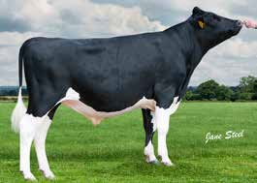
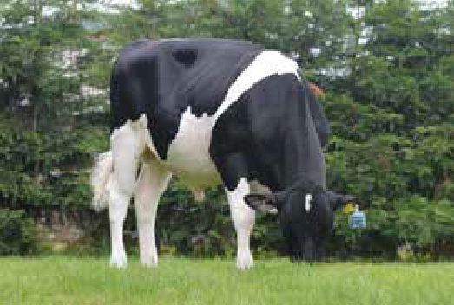
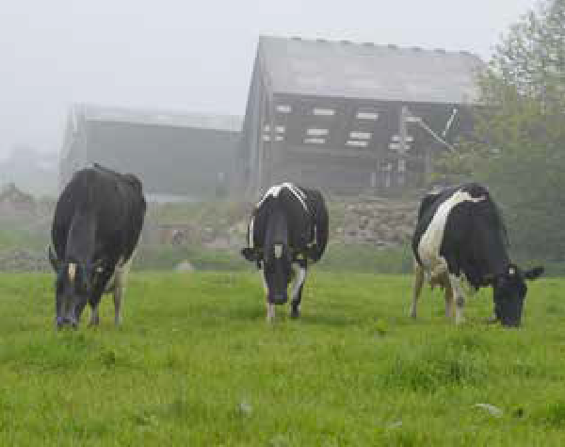

BRITISH FRIESIAN
LIFESPAN
COMPS
FERTILITY MAINTENANCE
BRITISH FRIESIAN
LIFESPAN
COMPS
FERTILITY
STRENGTH
Morcourt JEFFERIES
Goonhilly JOSEPH
HIGH
PURITY
Dam, GDam and GGDam
Jefferies comes from a block calving herd and has all the traits to produce the perfect grazing cow.
Jupiter x Consul x Glenalbyn HBN: BFGBRM321947405028
AI Code: BF1204 Breed: 97% FR 3% HO
Dam: Morcourt Blackberry 96 BFV87 2nd Dam: Morcourt Blackberry 76
Chad x Hylke x Glenalbyn
HBN: BRFGBRM387868200718
AI Code: BF1130 Breed: 98% BF 2% HO
Dam: Goonhilly Hyl Yasmin BFE93 8E
3rd Dam: Morcourt Blackberry 54 BFG+80
2nd Dam: Goonhilly Glen Yasmin BFE93 7E 3rd Dam: Goonhilly Yasmin
SCI & ACI Data
Source: AHDB Dairy-Dec 2020
SCI & ACI Data
Source: AHDB Dairy-Dec 2020
SCI | ACI | Rel %
331 | 325 | 65
-2
-1
0
1
2
SCI | ACI | Rel %
304 | 289 | 74
-2
-1
0
1
2
UK Type Merit |  | 0.77 | Excellent
UK Udder Comp |  | 0.83 | Excellent
UK Feet and Legs |  | 0.43 | Excellent
Stature |  | 0.37 | Taller
Chest Width |  | -0.22 | Narrow
Body Depth |  | 0.21 | Average
Angularity |  | 0.14 | Open Rib
Rump Angle |  | 0.83 | Lower
Rump Width | -0.33 |  | Narrow
Rear Leg Side | 0.01 |  | Sickled
Foot Angle | 0.16 |  | Steep
F.Udder Attach | 1 |  | Tight
R. Udder Height |  | 0.43 | Very High
Udder Support |  | 0.46 | Strong
Udder Depth |  | 0.78 | Shallow
F.Teat Placement |  | 0.32 | Close
Teat Length |  | -0.36 | Shorter
R.Teat Placement |  | 0.41 | Close
Teat Pos Side |  | 0.71 | Apart
Locomotion |  | 0.3 | Excellent
UK Type Merit |  | 0.97 | Excellent
UK Udder Comp |  | 1 | Excellent
UK Feet and Legs |  | 0.64 | Excellent
Stature |  | 0.58 | Taller
Chest Width |  | 0.87 | Wide
Body Depth |  | 0.65 | Deep
Angularity |  | 0.31 | Open Rib
Rump Angle |  | -0.33 | Higher
Rump Width | 0.21 |  | Wide
Rear Leg Side | 0.16 |  | Sickled
Foot Angle | -0.34 |  | Low
F.Udder Attach | 0.06 |  | Tight
R. Udder Height | 0.09 |  | Very High
Udder Support | 0.69 |  | Strong
Udder Depth | 0.16 |  | Shallow
F.Teat Placement |  | 0.3 | Close
Teat Length |  | -0.03 | Shorter
R.Teat Placement |  | 0.89 | Close
Teat Pos Side |  | 1.23 | Apart
Locomotion |  | 0.89 | Excellent
Milk Kgs | Fat Kgs | Protein Kgs | Prod Dtrs
-280 | -7.6 | -5 | 0
Rel % | Fat % | Protein % | Prod Hrds
69 | 0.09 | 0.1 | 0
Milk Kgs | Fat Kgs | Protein Kgs | Prod Dtrs
-383 | -6.8 | -5.6 | 19
Rel % | Fat % | Protein % | Prod Hrds
84 | 0.2 | 0.16 | 11
Production and fitness data supplied by AHDB.
SCC | Mastitis | Lameness | Lifespan
-4 | -1 | -0.4 | 106
Fert Index | Maint | TB Adv | D Carcase
13.2 | -7 | 1.1 | 1.3
Calf Surv | DcE | McE | D Dermatitis
2.7 | 0.9 | -0.4 | 0
Production and fitness data supplied by AHDB.
SCC | Mastitis | Lameness | Lifespan
0 | -2 | 0.1 | 66
Fert Index | Maint | TB Adv | D Carcase
10.2 | 1 | 5.1 | 3.1
Calf Surv | DcE | McE | D Dermatitis
4 | 1.1 | -0.7 | 0.5
Daughters in Herds | 0 Dtrs 0 Herds 55% Rel
Daughters in Herds | 0 Dtrs 0 Herds 58% Rel
TYPE DATA SUPPLIED BY HOLSTEIN UK SOURCE: HOLSTEIN UK – DEC 2020
TYPE DATA SUPPLIED BY HOLSTEIN UK SOURCE: HOLSTEIN UK – DEC 2020
32|
GENOMIC SIRE
PROVEN SIRE
|33

Slide 18
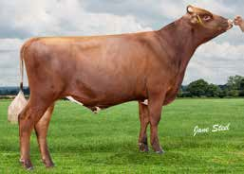
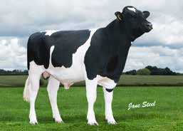
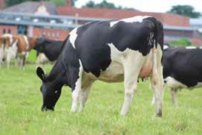

SCANDINAVIAN RED
HIGH SCI
COMPS
FERTILITY NEW
BRITISH FRIESIAN
FERTILITY
UDDER HEALTH
BALANCE
CALVING EASE
Whinnow ORIGIN
Aintree PENROD
HIGH
HIGH
PURITY
PURITY
Dtr Hollinscourt Penrod Sally BFV86
The new No.1 Genomic Scandinavian Red sire, Origin offers great balance throughout
his proof.
Fonseca x Gunnarstorp x R Facet HBN: AYGBRM000007191559
AI Code: A9049 Breed: 68% AY 32% SR
Hilton x Glen Albyn x Panatella HBN: BFGBRM706793503286
AI Code: BF1124 Breed: 97% FR 3% HO
Dam: Whinnow Gunnar Orreja 2
Dam: Blackisle Pauline 71 BFE95 (6)
2nd Dam: Skyhigh Facet Orreja 2 3rd Dam: 690 Orreja EX93 3E
2nd Dam: Blackisle Pauline 52 BFE90 3rd Dam: Blackisle Pauline 46
SCI & ACI Data
Source: AHDB Dairy-Dec 2020
SCI & ACI Data
Source: AHDB Dairy-Dec 2020
SCI | ACI | Rel %
104 | 140 | 46
-2
-1
0
1
2
SCI | ACI | Rel %
334 | 354 | 73
-2
-1
0
1
2
UK Type Merit |  | 0.5 | Excellent
UK Udder Comp |  | 0.5 | Excellent
UK Feet and Legs |  | 0.00 | Poor
Stature |  | 0.9 | Taller
Chest Width |  | 0.2 | Wide
Body Depth |  | -0.8 | Shallow
Angularity |  | -0.6 | Coarse
Rump Angle |  | 0.9 | Lower
Rump Width |  | 0.9 | Wide
Rear Leg Side |  | 0.2 | Sickled
Foot Angle | 1 |  | Steep
F.Udder Attach | 0.2 |  | Tight
R. Udder Height | 0.2 |  | Very High
Udder Support | -0.4 |  | Broken
Udder Depth | 0.4 |  | Shallow
F.Teat Placement | -0.7 |  | Outside
Teat Length | 0.2 |  | Longer
R.Teat Placement | N/A |  | Close
Teat Pos Side | N/A |  | Apart
Locomotion | N/A |  | Excellent
UK Type Merit | 0.87 | Excellent
UK Udder Comp | 0.92 | Excellent
UK Feet and Legs | 0.75 | Excellent
Stature | 0.16 | Average
Chest Width | 0.21 | Wide
Body Depth | 0.56 | Deep
Angularity Rump Angle | 0.54 | Open Rib
 | -0.69 | Higher
Rump Width | 0.05 | Wide
Rear Leg Side | -1.24 | Straight
Foot Angle | 0.73 | Steep
F.Udder Attach | 0.05 | Tight
R. Udder Height | 0.84 | Very High
Udder Support | 0.75 | Strong
Udder Depth | -0.43 | Deep
F.Teat Placement | 0.71 | Close
Teat Length | 0.57 | Longer
R.Teat Placement | 0.96 | Close
Teat Pos Side | 1.75 | Apart
Locomotion | 0.48 | Excellent
Milk Kgs | Fat Kgs | Protein Kgs | Prod Dtrs
104 | 5.5 | 6.3 | 0
Rel % | Fat % | Protein % | Prod Hrds
46 | 0.02 | 0.05 | 0
Milk Kgs | Fat Kgs | Protein Kgs | Prod Dtrs
41 | 2.9 | 2.7 | 12
Rel % | Fat % | Protein % | Prod Hrds
81 | 0.02 | 0.03 | 6
Production and fitness data supplied by AHDB.
SCC | Mastitis | Lameness | Lifespan
2 | N/A | N/A | 39
Fert Index | Maint | TB Adv | D Carcase
2.6 | -1 | N/A | N/A
Calf Surv | DcE | McE | D Dermatitis
N/A | N/A | N/A | N/A
Production and fitness data supplied by AHDB.
SCC | Mastitis | Lameness | Lifespan
-8 | -3 | 0.7 | 66
Fert Index | Maint | TB Adv | D Carcase
7.9 | -7 | 0.9 | 2.1
Calf Surv | DcE | McE | D Dermatitis
1.3 | 0.9 | -0.2 | 0.1
Daughters in Herds | 0 Dtrs 0 Herds 49% Rel
Daughters in Herds | 0 Dtrs 0 Herds 58% Rel
TYPE DATA SUPPLIED BY HOLSTEIN UK SOURCE: HOLSTEIN UK – DEC 2020
TYPE DATA SUPPLIED BY HOLSTEIN UK SOURCE: HOLSTEIN UK – DEC 2020
34|
GENOMIC SIRE
GENOMIC SIRE
|35

Slide 19

96₉₇
%
%*
THE MOST PRECISE
SEX-SORTED SEMEN IN THE MARKET: 96 TO 97%* GENDER ACCURACY!
AHDB. AHDB.
by by
supplied supplied
data data
fitness fitness
and and
Production Production
36| |37
OUR PROMISE JUST GOT STRONGER ...
* The semen collections being marketed under this program have gender purity of 96% to 97%.

Slide 20
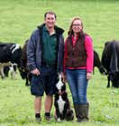


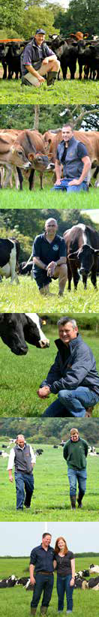




NORTH TEAM
SOUTH TEAM
Andy Hales Regional Sales Manager | 07818 | 573379
Alan Robson | 07554 | 401234
Andrew Howie | 07977 | 281073
John Howie | 07977 | 281074
Jenny Murtagh | 07736 | 291226
Richard Lapthorne | 07794 | 657040
Michael Stobbart | 07889 | 807969
Rachel Richardson | 07593 | 452120
William Salt | 07855 | 506136
Graham Higgott Regional Sales Manager | 07787 283117
Megan Middleton Business Development Manager | 07719 511692
Chris Horton | 07813723677
David Willcox | 07827 243249
Lisa Hopwood | 07772 976935
Martin Ley | 07818 573481
Amanda Clements | 07711 593941
Mike Potter | 07772 202045
Sarah Robertson | 07519 120676
Stuart Bright | 07531 244135
CENTRAL TEAM
Andy Hales Regional Sales Manager | 07818 | 573379
David Heath | 07791 | 045427
James Joule | 07519 | 120671
Jemma Lindley | 07710 | 093064
Phil Wynn | 07889 | 538859
Robert Davies | 07939 | 333141
COGENT CYMRU
Graham Higgott Regional Sales Manager | 07787 | 283117
Cogent Cymru Office | 01495 | 753555
Sian Jones | 07972 | 534303
Samantha Alexander | 07719 | 524082
Kevin Rickard | 07800 | 534621
Dafydd Williams | 07719 | 524078
Glyn Williams | 07866 | 126072
Philip Douch | 07593 | 452115
NORTHERN IRELAND
Ashley Fleming Regional Sales Manager | 07775 | 561823
Adrian McPhillips | 07919 | 553968
Edwin Black | 07710 | 968305
Stephen Shanks | 07972 | 704738
Jamie Sproule | 07827 | 304010
Jamie Farry | 07593 | 452116
Jonathan Kelso | 07719 | 524123
Paul Murtagh | 07775 | 935221
£
INTERNAL SALES
Jane Winters Internal Sales Manager | 01829 | 773435
Catherine Perelli | 01829 | 773425
Carla Madeley | 01829 | 773421
Chloe Evans | 01829 | 773422
Emma Minshall | 01829 | 773493
Lisa Boughey | 01829 | 773420
Olivia Butler | 01829 | 773426
AHDB.
by
supplied data
fitness and
Production
4|
COGENT PRECISION MATCH EVALUATORS
Christina Straathof North | 07989 | 219683
Amy Hall Brown South | 07718 | 210066
Katie Evans South | 07531 | 648419
Phil Wynn Central | 07889 | 538859
Kevin Rickard Wales | 07800 | 534621
Jamie Sproule N. Ireland | 07827 | 304010
COGENT PRECISION SERVICES
Gary Pleavin
Precision Operations Manager
07841 340361
Part of the
www.stgen.com
group.
Michael Jones
Precision Technical Manager
07584 238635
38|
|39

Slide 21
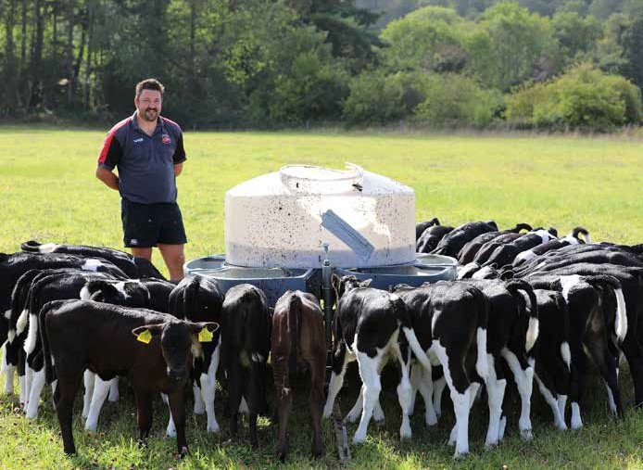
GRAZING
SPRING 2021 CATALOGUE

